Slide 1
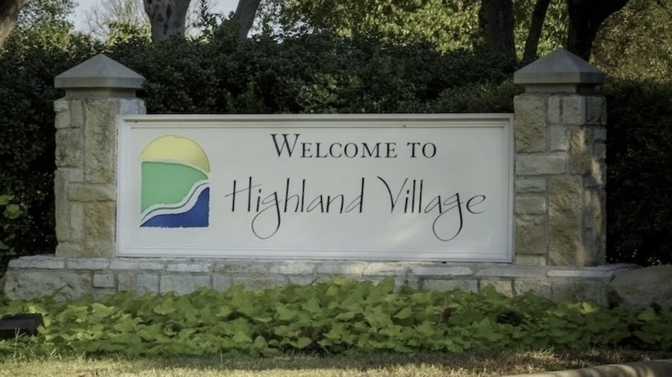
City of Highland Village
Succession Planning Project
Presented By: J.K.M Consulting
Jacqueline Beltran, Kishan Belakkal, and Mrunalinee Desai

Slide 2
Agenda
Introduction
Meet the Team
Project Details
Key Objectives and Resources
COHV Data and Research
Fire Department Succession
Parks and Recreation Succession
Recommendations
Wrap-Up
Notes:
Mrunalinee

Slide 3

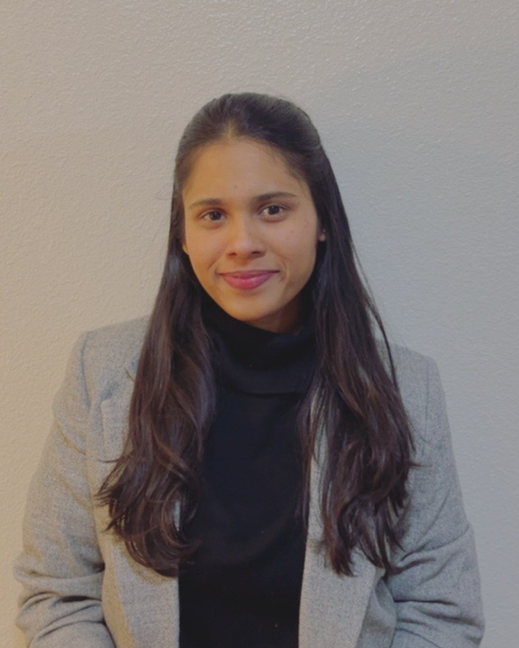
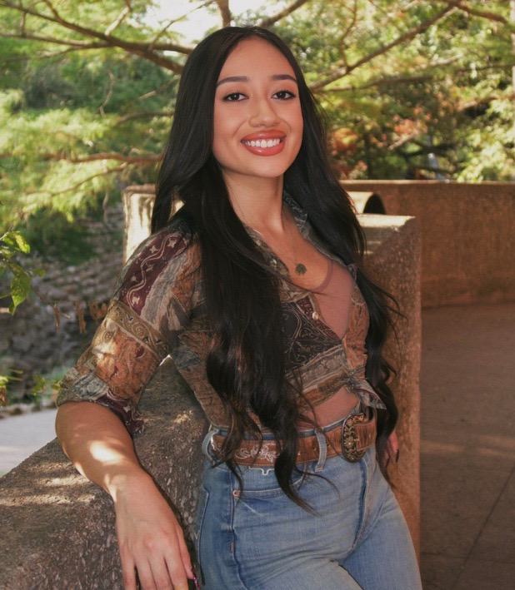

Meet the Team: J.K.M Consultants
Jacqueline Beltran
MBA/MSHR
Kishan S B
Masters of Business Analytics
Mrunalinee Desai
(Project Manager)
Masters of Information Systems
Notes:
Munalinee

Slide 4
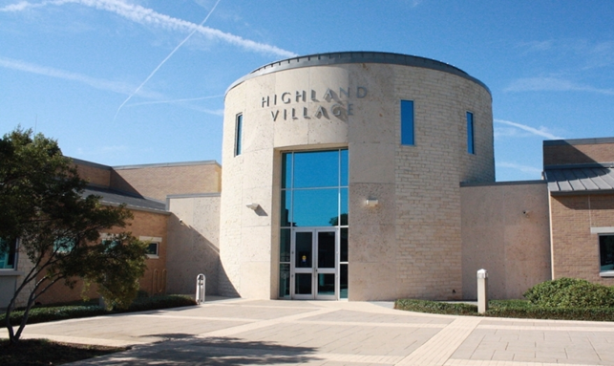
Project Overview
The City of Highland Village is strengthening succession planning across departments.​
Initial focus will be on the Fire Department and Parks & Recreation.​
Goal: Reducing operational risk caused by upcoming retirements and knowledge loss.​
Emphasis on long-term organizational stability and workforce continuity.
Notes:
Mrunalinee

Slide 5
Key Objectives and Resources
Key Objectives
Conduct research and benchmark succession planning best practices.​
Analyze Fire and Parks & Recreation workforce structure.​
Identify critical roles and development needs.​
Assess certification, compliance, and specialized role requirements.​
Recommend strategies for knowledge transfer, internal development, and external hiring.​
Align recommendations with city operational needs.
Resources
Organizational charts showing reporting structure. ​
Critical role responsibilities by position.​
Required certifications and licenses by role.
Training records (leadership, technical, compliance). ​
Performance and promotion eligibility data.​
Known retirements and vacancies expected within 3–5 years. ​
External research from the U.S. Census Bureau, U.S. Bureau of Labor Statistics, Highland Village community newsletters, and COHV public archives and financial reports.
Notes:
Mrunalinee

Slide 6
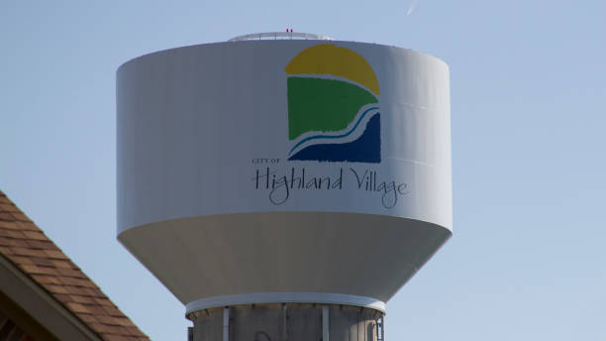
Highland Village Succession Planning External Research:
Actual numbers as of 2024-2025 for the Fire Department and Parks & Recreation
Fire is prioritized because the service model is smaller, more certification-heavy, and more sensitive to single-position gaps.
Population (2024)
Fire calls (2024)
Parks footprint
16,137
1,753
335+
Highland Village residents
Official annual incident volume
Acres of parkland maintained
Source: census.gov/quickfacts/fact/…
Source: highlandvillage.org/817/Fir…
Source: highlandvillage.org/149/Par…
Notes:
Jacky

Slide 7
1. Local context: small city, small internal bench
REGIONAL COMPARISON
Compared with nearby peers, Highland Village has a much smaller population, therefore also having a much smaller employee bench. That makes each departure harder to absorb—especially in leadership roles where experience is concentrated.
2020→2024 growth
2020→2024 growth
2020→2024 growth
+1.5%
+8.2%
+18.7%
Highland Village
Lewisville
Denton
Source: census.gov/quickfacts/fact/…
Source: census.gov/quickfacts/fact/…
Source: census.gov/quickfacts/fact/…
HIGHLAND VILLAGE CONSTRAINTS
Population
16.8% of residents are 65+
Aging residents can mean sustained demand for EMS, accessibility, and park maintenance responsiveness.
Source: census.gov/quickfacts/fact/…
≈96% built out; ~200 homes remain; full build-out projected by 2030
That matters for succession planning: Highland Village cannot count on major population growth alone to create a deeper internal talent pool or a sharply larger tax base.
Population source: census.gov/quickfacts/fact/…
Source: highlandvillage.org/Archive…
Peer source: census.gov/quickfacts/fact/…
Peer source: census.gov/quickfacts/fact/…
Notes:
Jacky

Slide 8
2. Fire Department: demand is rising inside a compact service model
DEMAND TREND
Official incident volume dipped in 2023, then rose to a new three-year high in 2024. For a one-station department, even modest call growth matters because overlapping incidents hit staffing quickly.
2023→2024
2024 call rate
Daily average
+8.1%
108.6
4.8
increase in annual calls
incidents per 1,000 residents
calls per day in 2024
Calc from: highlandvillage.org/817/Fir…
Calc from: highlandvillage.org/817/Fir…
Calc from: highlandvillage.org/817/Fir…
Annual Call Volume
CURRENT OPERATING MODEL
EMS model
MICU staffed by 2 firefighter/paramedics
Paramedic Engine staffed by minimum 3 firefighter/paramedic-certified personnel
• 3 shifts (A, B, C)
• full staff of 6 per shift; minimum staffing of 5
• frontline + reserve Paramedic Engine
• frontline + reserve MICU Medic
• Type 6 Wildland Engine
Source: highlandvillage.org/817/Fir…
Population for rate: census.gov/quickfacts/fact/…
Source: highlandvillage.org/814/Fir…
Notes:
Jacky

Slide 9
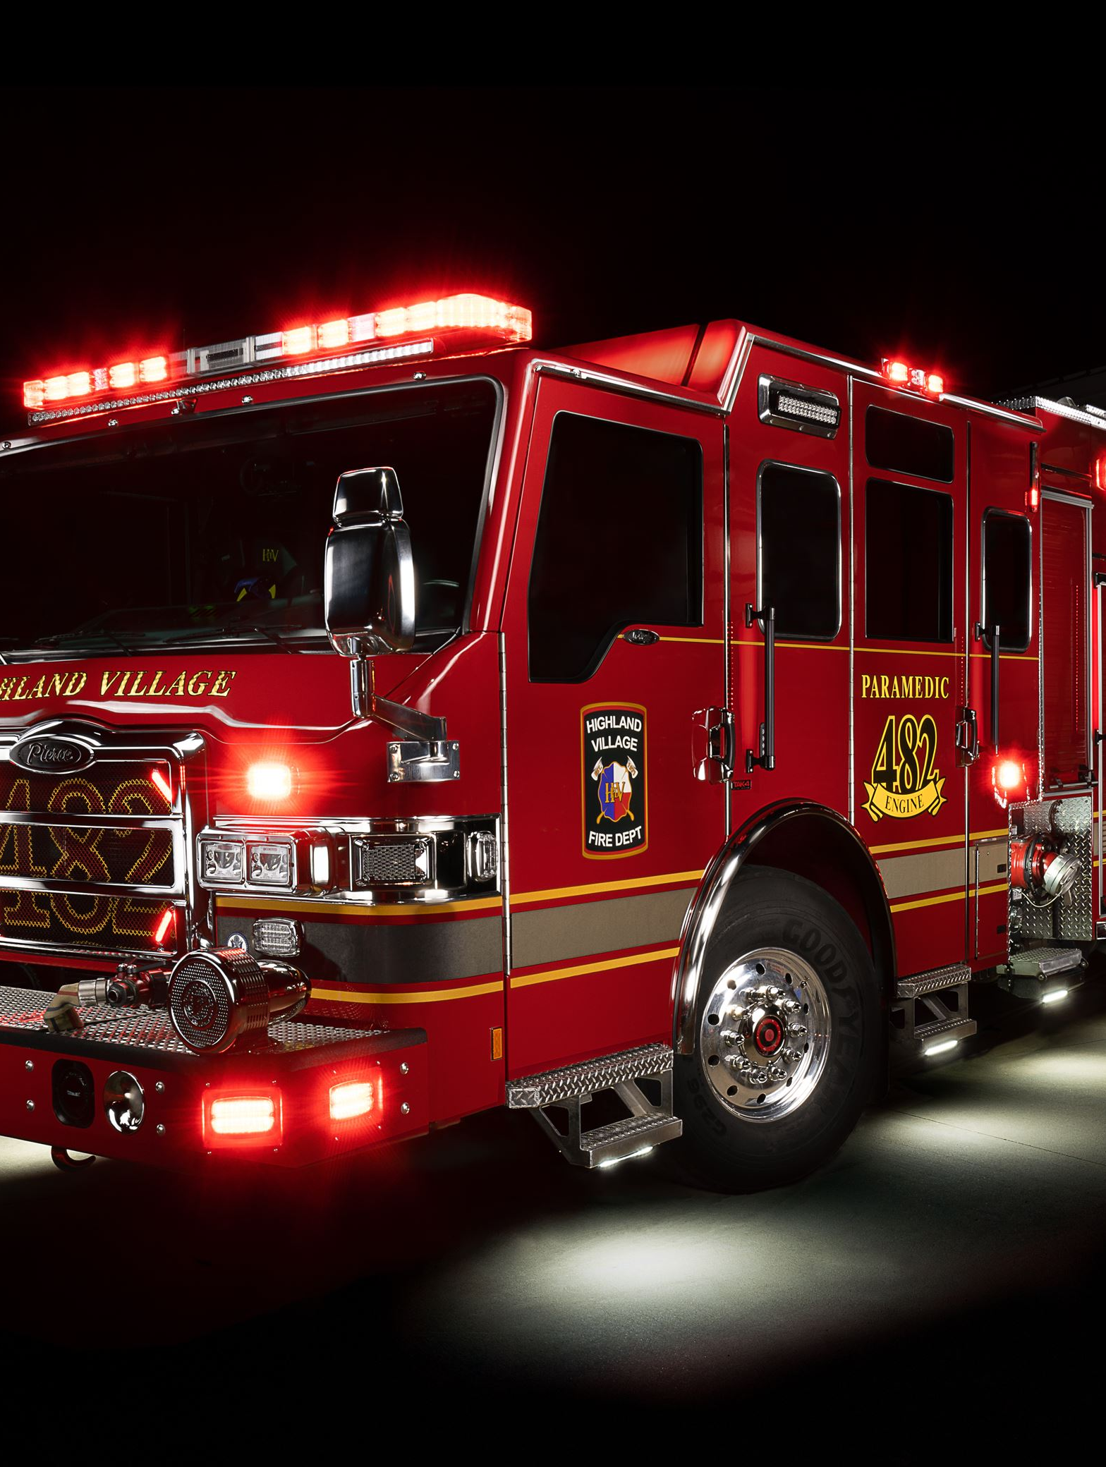
3. Fire Succession Risk: certifications, training time, and thin backup capacity
Minimum hire bar
Internal training load
National labor market
Dual credentials
20+ hrs/mo
27,100
HV requires Paramedic certification plus TCFP commissioned firefighter status.
Monthly fire training exceeds the state continuing education minimum cited on the city page.
average annual firefighter openings projected by BLS, 2024–2034.
Source: highlandvillage.org/820/Rec…
Source: highlandvillage.org/814/Fir…
Source: bls.gov/ooh/protective-serv…
Paramedic market
Historic pressure signal
Mutual-aid delay
19,000
+37%
6-9 min
average annual EMT/paramedic openings projected by BLS, 2024–2034.
increase in overlapping calls cited in a 2021 local review discussion.
average added response time cited when aid must come from outside the city.
Source: bls.gov/ooh/healthcare/emts…
Source: communityimpact.com/dallas-…
Source: communityimpact.com/dallas-…
Succession Implication
Why the fire bench is harder to build
Build a two-deep bench early for captain/driver/paramedic roles. In Highland Village, the replacement cycle includes certification, field training, shift integration, and daily readiness—not just hiring.
Replacing a leader usually means replacing a dual-certified, shift-ready responder—not just filling a generic vacancy.
Sources: highlandvillage.org/820/Rec…
: highlandvillage.org/814/Fir…
: bls.gov/ooh/protective-serv…
: bls.gov/ooh/healthcare/emts…
Notes:
Jacky

Slide 10
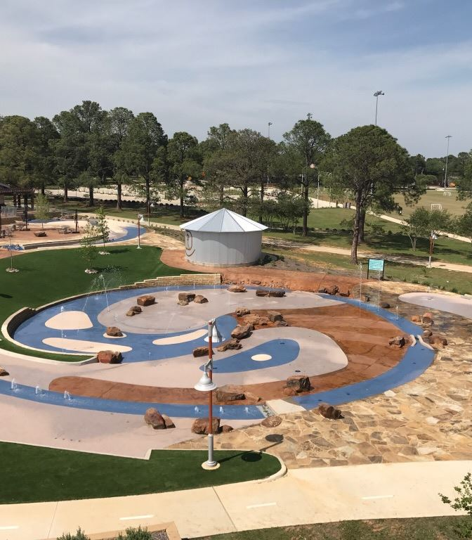
4. Parks & Recreation: Fewer site-safety stakes, but a wide physical operating span
Pilot Knoll
Campground inventory
Day-use inventory
65–85 acres
55 sites
32 tables
Lake Lewisville park footprint varies with water level.
RV/tent campsites with 50-amp hookups.
Covered and uncovered picnic tables with grills.
Source: highlandvillage.org/facilit…
Source: highlandvillage.org/facilit…
Source: highlandvillage.org/facilit…
BUDGET + RECENT INVESTMENT
Examples cited in the 2025 ACFR:
• $298,011 overlay work at Pilot Knoll + Copperas Branch
• $126,787 splash pad upgrades
• $99,694 electrical improvements at Doubletree Ranch Park
• $86,240 trail alignment assessment for FM 407
FY 2025/2026 Parks budget: $2.686M
FY 2025 Parks & recreation expenses: +$667k year over year
Parks System Scale
Budget source: highlandvillage.org/Archive…
Project source: highlandvillage.org/Archive…
335+ acres of public parkland
19 city-owned or leased park sites
23.6 acres of multiuse trails
A small leadership gap can slow maintenance scheduling, vendor coordination, campground operations, special events, and field readiness all at once.
Succession implication: parks leadership needs strong cross-training across assets, events, facilities, and campground operations so site knowledge does not leave with one supervisor.
Source: highlandvillage.org/149/Par…
Notes:
Jacky

Slide 11
5. Budget and Capital Evidence: Succession is also a Continuity Issue
Highland Village is putting real dollars behind both departments. That makes knowledge transfer more important: the city is not just replacing people, it is protecting operating decisions tied to staffing, apparatus, sites, and vendors.
Public safety personnel cost shift
Parks expense shift
+$767,595
+$666,793
FY 2025 increase in personnel costs tied mainly to a 6% market adjustment and the addition of a firefighter/paramedic position.
FY 2025 parks & recreation increase driven by overlay, trail, splash pad, and electrical work plus event return.
Source: highlandvillage.org/Archive…
Source: highlandvillage.org/Archive…
Budget (in Millions of Dollars)
Fire equipment in 2024 tax note
Parks equipment in 2024 tax note
$1.20M
$228k
Ambulance $450k + Ambulance $480k + Brush Truck $270k.
Large Tractor $105k + Small Tractor $60k + Athletic Mower $63k.
Source: highlandvillage.org/Archive…
Source: highlandvillage.org/Archive…
Fire budget is 1.64× the Parks budget, but both departments carry equipment and site knowledge that becomes vulnerable when experienced staff leave without handoff.
Source: highlandvillage.org/Archive…
Sources: highlandvillage.org/Archive…
: highlandvillage.org/Archive…
: highlandvillage.org/Archive…
Notes:
Jacky

Slide 12
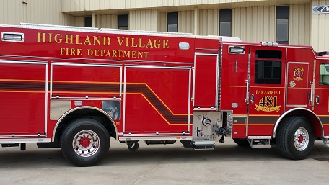
COHV Fire Department Succession Planning

Slide 13
Fire Department Succession Reality
Based on the internal Fire Department spreadsheet, there are 23 employees included in the succession review.
The biggest issue is that no employees are marked as “Ready Now” for leadership promotion.
Most of the concern comes from two areas:
High-risk roles are tied to retirement eligibility or important leadership positions
Medium-risk roles are mostly tied to external job market demand
This means the department may be staffed right now, but it does not have many people ready to step into leadership roles immediately.
Main Point:
The Fire Department has people in the pipeline, but not enough people ready to take over right away.
Notes:
Kishan

Slide 14
Why Fire Department Succession Takes Longer
Fire Department promotions are not simple because employees need several certifications and years of experience before moving up.
For leadership roles, employees may need:
Paramedic certification
TCFP firefighter certification
Fire Officer certifications
ICS / incident command training
Experience leading crews or shifts
This makes succession planning harder because someone may be a good future candidate, but still not ready today.
Why this matters:
If a vacancy happens soon, the department may have to rely on acting assignments or outside hiring.
Notes:
Kishan

Slide 15

Existing Fire Department Successor Pipeline
The spreadsheet shows that the department does have a possible succession path. The issue is that most of these people are still future options, not immediate replacements.
Fire Chief Level
Existing: GREEN, RICKIE S
Backup: Kevin Gosselin, Assistant Chief
Long-term replacement may require outside hiring or more internal development
Captain to Assistant Chief Pipeline
Existing:
Assistant Fire Chief: GOSSELIN, KEVIN J
Backup: Chief Green, Fire Chief
Captain: Sorbsy Tony, Daniel Ortmeier, Jared Middleton L
Backup: Chief Green or Kevin Gosselin
Driver/Operator to Captain Pipeline
Existing: HARPER M, Justin Moore, Robert Dukes, Joshua Mabry, Jared Carlsen
Backup: Stepup Fire Fighters
FF/Paramedics and Support Pipeline
Existing:
FF/Paramedics: Tony, Benjamin, Shilo, Austin, Moore, Abigail Harris, Nathan Thomas, Chase M, Mathew, Caleb, Joseph
Fire Support Spec: Charlene Seildl
Notes:
Kishan

Slide 16
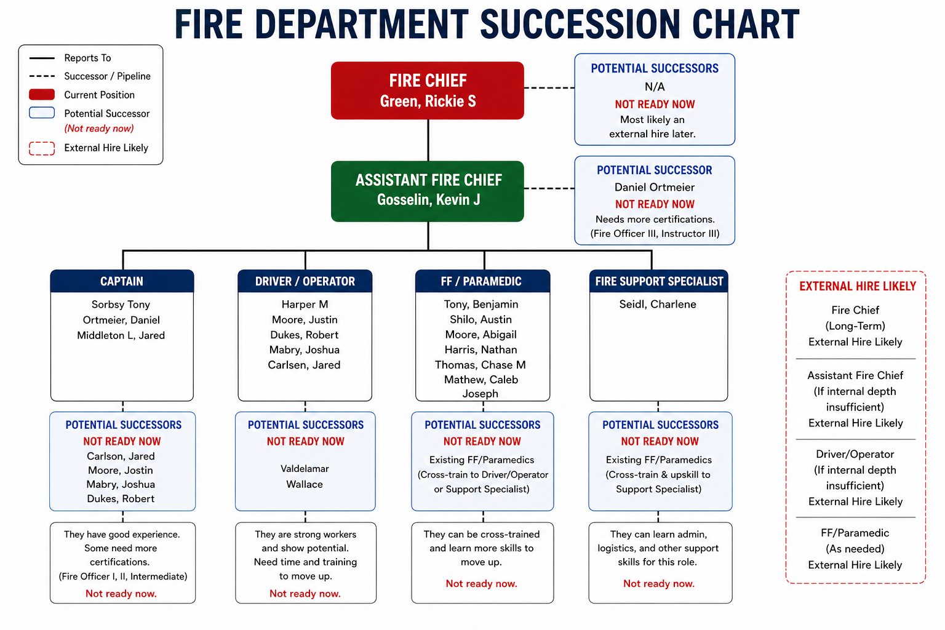
Proposed Fire Department Succession Plan
Notes:
Kishan

Slide 17
Proposed Fire Department Succession Plan
Role/position | Potential Successor names | Backup Coverage | Potential future eligible successor | Reason | Recommendation
FIRE CHIEF | Chief Green | Asst. Chief: Kevin Gosselin | Outside Hire | Chief Green is expected to retire in ~10 years Average tenure for a Fire Chief role is ~5 years → succession planning needed earlier No internal candidates are currently qualified or interested Kevin Gosselin (Assistant Chief) is also nearing retirement → not a viable successor | No immediate successor available. External hire required, with internal pipeline development as backup
ASST FIRE CHIEF | N/A | Fire Chief: Chief Green | Outside Hire | Chief Gosselin plans to work another 6–8 years No internal candidates currently interested in the role High probability of external hiring for replacement Daniel Ortmeier identified as a potential long-term successor Not immediately eligible due to missing certifications (Fire Officer III, Instructor III) Strong experience but needs additional technical and credential development Decision path: develop Daniel vs. hire externally | Strong reliance on external hiring unless development begins now. Clear opportunity to invest in structured training and career progression.
FIRE CAPTAIN | N/A | Chief Green OR Kevin Gosselin | Carlson Willoughby Mabry Dukes Moore | Robert Dukes: Expected to retire in 3–4 years → not a long-term priority Can be retained short-term if immediate coverage is needed Joshua Mabry: Viable internal successor candidate Promotion gaps (key blockers): Justin Willoughby → Needs Fire Officer II Jared Carlson → Needs Fire Officer I, II, and Intermediate Justin Moore→ Needs Fire Officer II | Internal pipeline exists but is under-qualified → Prioritize upskilling ,certification and development plans to promote near-ready candidates
Notes:
Kishan

Slide 18
Proposed Fire Department Succession Plan
Role/position | Potential Successor names | Backup Coverage | Potential future eligible successor | Reason | Recommendation
FIRE DRIVER/OPERATOR | N/A | Stepup Fire Fighters | Valdelamar Wallace | Harper is expected to retire soon → immediate vacancy risk No clearly identified internal successor Limited time to prepare internal candidates | High likelihood of external hiring to ensure continuity
FF/PARAMEDIC | N/A | N/A | N/A | Outside Hire | Multiple FF/Paramedics could be upskilled for this role in this way we will have backup for FIRE DRIVER/OPERATOR Cross-training and sponsorship can prepare candidates in advance
FIRE SUPPORT SPEC | N/A | N/A | N/A | Outside Hire | Potentially eligible FF/Paramedics can be upskilled into support roles in this way we will have backup for FIRE SUPPORT SPEC Cross-training and sponsorship can prepare candidates in advance
Notes:
Kishan

Slide 19
Proposed Fire Department Strategy & Development Plan
The goal should be to move employees from “possible successor” to “ready successor.”
How Does This Connects to a Two-Deep Leadership Bench?
This approach supports building a two-deep leadership bench, where each critical role has:
One primary successor
One backup successor
This matters because it prevents the department from relying on just one person and helps ensure coverage if a vacancy happens unexpectedly.
Main Point:
The department does not need to start from scratch. It already has possible successors, but they need a clear plan to become ready.
Short-Term: 0–1 Year
Use acting assignments when needed
Identify who is closest to being ready
Start individual development plans for each potential successor
Mid-Term: 1–3 Years
Help employees complete required certifications
Give future leaders more shift leadership experience
Focus on Driver/Operator to Captain development
Long-Term: 3–5 Years
Prepare stronger candidates for Captain and Assistant Chief roles
Build a deeper internal leadership pipeline
Reduce dependence on outside hiring
Notes:
Mrunalinee

Slide 20
Additional Recommendations for Fire Department
Internal development of successors is a cost-effective and sustainable long-term strategy that ensures continuity in specialized roles.
External hiring may be required to fill gaps quickly, but dependency on external hiring could be minimized wherever possible, especially for roles below Assistant Fire Chief.
There is a risk of short-term gaps if transitions are not planned early.
Provide training and exposure to the team across various catastrophic situations, such as wildfires and natural disasters, to motivate and keep them engaged.
If there are limitations in sponsoring paid certifications or training, identify the most reliable and high-performing candidates and require them to complete mandatory training within a defined timeline, while clearly communicating the future benefits of the program.
Consider sending selected team members to nearby counties like Dallas or other busy cities for exposure to emergencies they have not handled before, possibly on a quarterly exchange basis.
Also, bring in personnel from other counties to learn and share how fire departments operate across Highland Village.
Notes:
Jacky

Slide 21
Additional Recommendations for Fire Department
Create a written succession plan policy
Designate a Succession Plan Administrator (e.g., the Assistant Fire Chief) responsible for annual reviews and updates.
Conduct annual succession readiness reviews
Publish internal readiness dashboards
For every rank of Captain and above, identify at least two successors and create personalized IDPs for each.
Establish a formal Acting Captain / Acting Driver-Operator rotation program
Adopt Certification Incentive Pay: Rather than bearing full sponsorship costs upfront, incentive pay rewards completed certifications
Negotiate a quarterly officer exchange program with Lewisville and Flower Mound, where developing officers spend 1–2 shifts embedded in a neighboring department's operations
Establish a Mentorship Program: monthly meetings, quarterly goal reviews, and written progress notes.
Partner with local community colleges (e.g. North Central Texas College, Tarrant County College) to create an internship or ride-along program for fire science students
Notes:
Jacky

Slide 22
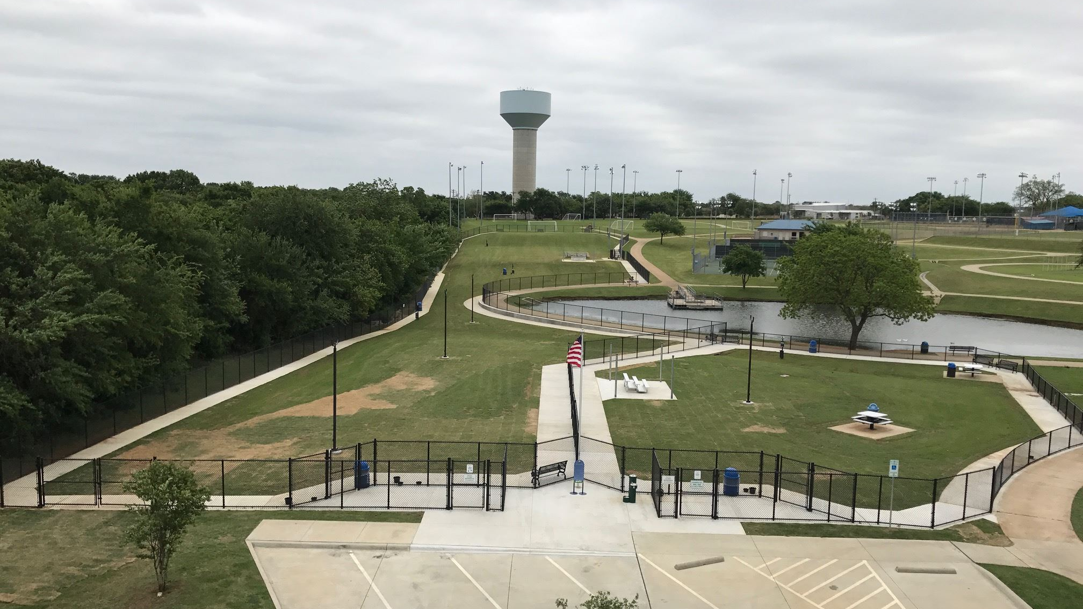
COHV Parks and Recreation Department Succession Planning

Slide 23
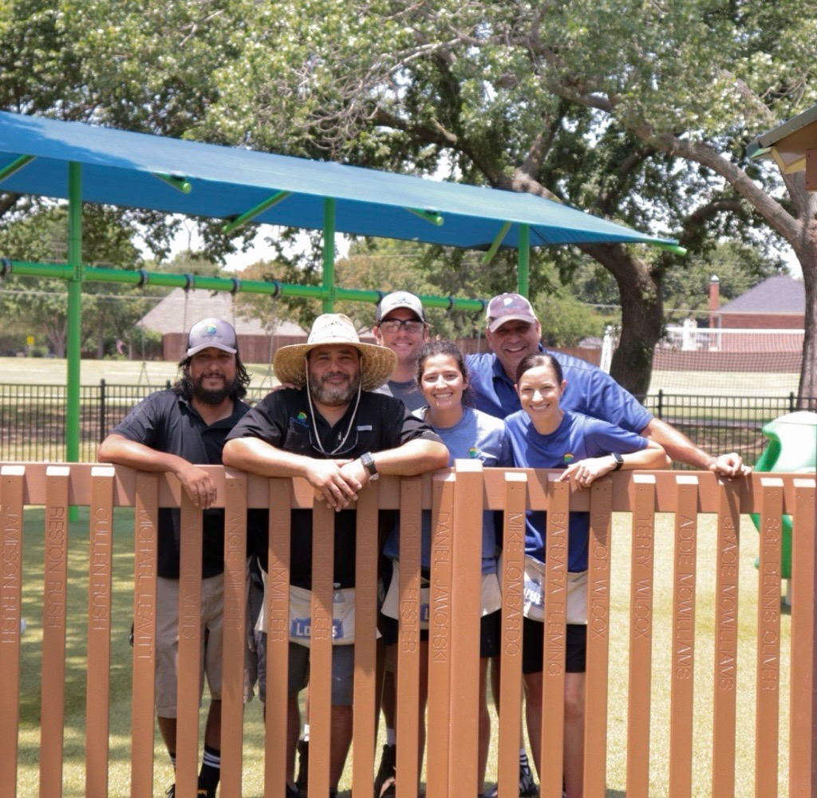
Parks Leadership Current Structure
Top-Level Leadership:
Director (Phillipe Lozano)
Responsible for department-wide planning, budgeting, and operations
Assistant Director Level:
Brian Norton (Parks Operations)
Andra Foreman (Recreation operations)
Manage divisions, staff, and long-term planning
Mid-Level Leadership:
Parks Superintendent (Gabriel Doria)
Parks Supervisor (Phillip Schmidt)
Parks Crew leader (Ignacio Gomez, Justin Morgan, Jorge, Joseph, Hector, Justin)
Parks Irrigation / Project Specialist (Jesus Contreras)
Pest control/herbicide technician (Brent Hill)
Parks Tech II (Ignacio, Rafael, Yeison, Scott, Manuel, Luis)
Parks Tech I (Joshua, Mark, Christopher, Evan)
Recreation Supervisor (Scott, Deborah J)
Involved in daily operations, staff supervision, and project coordination
Notes:
Kishan

Slide 24
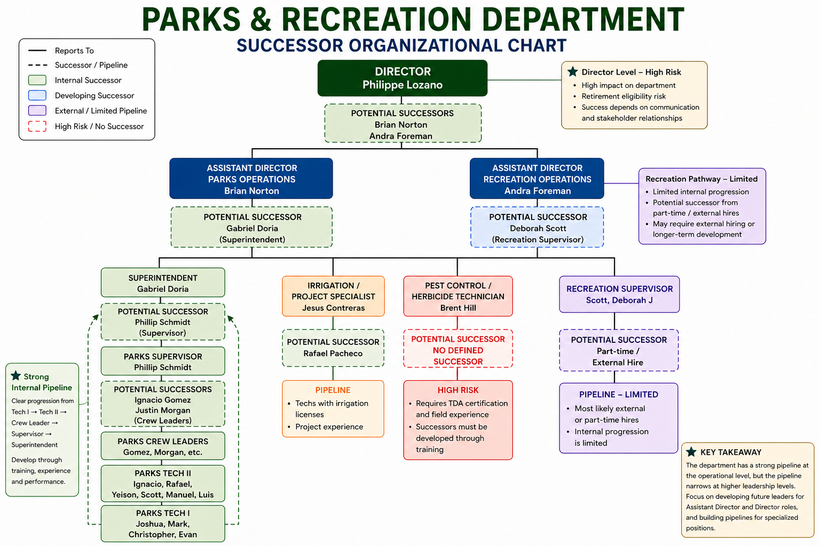
Parks Leadership Structure & Successor Coverage
Notes:
Kishan

Slide 25
Risk of Vacancy & Impact of Vacancy
The workforce data shows that risk and impact increase as you move up the organization, with leadership roles being the most vulnerable.
High Risk / High Impact Roles:
Director (Lozano)
Assistant Directors (Norton, Foreman)
Superintendent (Doria)
These roles are high risk due to:
retirement eligibility
limited qualified replacements
Manage divisions, staff, and long-term planning
They are high impact because they control:
planning and budgeting
staff and operations
decision-making across the department
Must be able to communicate and build connections with all stakeholders
High Risk / Medium Impact Roles:
Parks Supervisor (Schmidt)
Crew Leaders (Gomez, Ponce, Hardin, Calderon, etc.)
Important for daily operations, crew management and project coordination
Easier to cover temporarily compared to leadership roles
Medium Risk / Lower Impact Roles:
Technicians (Tech I / Tech II)
Specialists (Irrigation, Pest Control)
More employees available
Easier to replace or cross-train
Key Observation:
Leadership roles have capable successors, but must have more than one backup option
Specialized roles have skill-based gaps, even when staffing is stable
Lower-level roles have more flexibility due to a larger workforce
The issue is not a lack of capable employees, but a lack of multiple ready options for each role, which increases risk if more than one vacancy occurs.
Notes:
Kishan

Slide 26
Proposed Parks & Recreation Succession Strategy & Development Plan
The goal is to move from having identified successors to having multiple prepared options for each key role
How Does This Connects to a Two-Deep Leadership Bench?
Each key role should have:
One primary successor
One backup successor
This helps:
Reduce risk if someone leaves unexpectedly
Improve flexibility in promotions
Ensure there is more than one option available at each level
Main Point:
The department already has capable successors but needs to build more backup options and prepare multiple people for each role, not just rely on one.
Short-Term: 0–1 Year
Confirm current successor assignments based on updated data
Mid-Term: 1–3 Years
Strengthen Supervisor and Superintendent roles through:
Long-Term: 3–5 Years
Prepare stronger internal candidates for:
administrative support
technical positions
Begin developing backup options for roles that currently have only one successor
recreation roles
Use cross-training to support:
Identify employees who are closest to being ready for promotion
project management experience
budgeting and planning exposure
Continue technical development:
hands-on operational experience
Expand the number of employees who could step into key roles
leadership training
certifications (CPO, CPRP, irrigation, TDA, etc.)
Director roles
Reduce reliance on a single successor for each leadership position
Build more consistent coverage across both operations and recreation
Assistant Director
Notes:
Mrunalinee

Slide 27
Additional Recommendations for Parks and Recreation
Introducing potential future eligible successors to higher roles like shadowing and cross training so that they would feel more interested and involved.
If there are limitations in sponsoring paid certifications or training, identify the most reliable and high-performing candidates and require them to complete mandatory training within a defined timeline, while clearly communicating the future benefits of the program.
There is a risk of short-term gaps if transitions are not planned early. Internal development of successors is a cost-effective and sustainable long-term strategy that ensures continuity in specialized roles.
External hiring may be required to fill gaps quickly, but dependency on external hiring could be minimized wherever possible, especially for roles below Assistant Director.
Notes:
Jacky

Slide 28
Additional Recommendations for Parks and Recreation
Create a documented succession plan
Publish career pathway diagrams and make them available to all employees so they can see their growth trajectory clearly
Implement a structured rotation program
Create a cross-training checklist that documents skills gained during rotations.
Tie cross-training completion to eligibility for promotion.
Address the Language Barrier Through Bilingual Development: Consider bilingual competency as a positive factor in promotional evaluations, not just a barrier.
Implement a Knowledge Management System: create documented standard operating procedures (SOPs) for their critical responsibilities. Build a shared knowledge repository.
  Irrigation system maps and maintenance schedules
  Pesticide application protocols and regulatory compliance guides
Adopt Certification Incentive Pay and Tuition Reimbursement: Explore tuition reimbursement for employees pursuing degrees or certificates in parks management, recreation administration
Strengthen the External Pipeline: Partner with UNT, TWU, UTD or UTA programs in recreation/sport management to create internship pipelines
Adopt a City-Wide Learning Management System (LMS): Implement a city-wide LMS to track training completions, certifications, and IDP progress across both departments.
Conduct Annual/Biannual Employee Engagement Surveys with questions specifically about: Career development satisfaction, Perceived promotional opportunities, Training accessibility and quality, Supervision and mentorship quality, Retention intent (likelihood to stay 2+ years) and Use survey results to refine succession planning priorities annually.
Notes:
Jacky

Slide 29

Wrap-Up: Overall Succession Planning Takeaways
Key Findings
• Both the Fire Department and Parks and Rec have clear structures and some successors
• Many employees are not ready yet, especially in the fire department
• Parks and Rec has more coverage, but less backup at higher leadership roles
Main Risks
• Important leadership roles in both departments do not have ready replacements
• Fire roles need a lot of training and certifications, which slows things down
• Most roles depend on only one main successor
Recommendations
• Build a two-deep leadership bench in both departments
• Have one main successor and one backup for each role
• Focus on training, certifications, and cross-training
Goals
• Have multiple people ready for each key role in both departments
• Reduce risk and keep operations running smoothly
Notes:
Mrunalinee

Slide 30
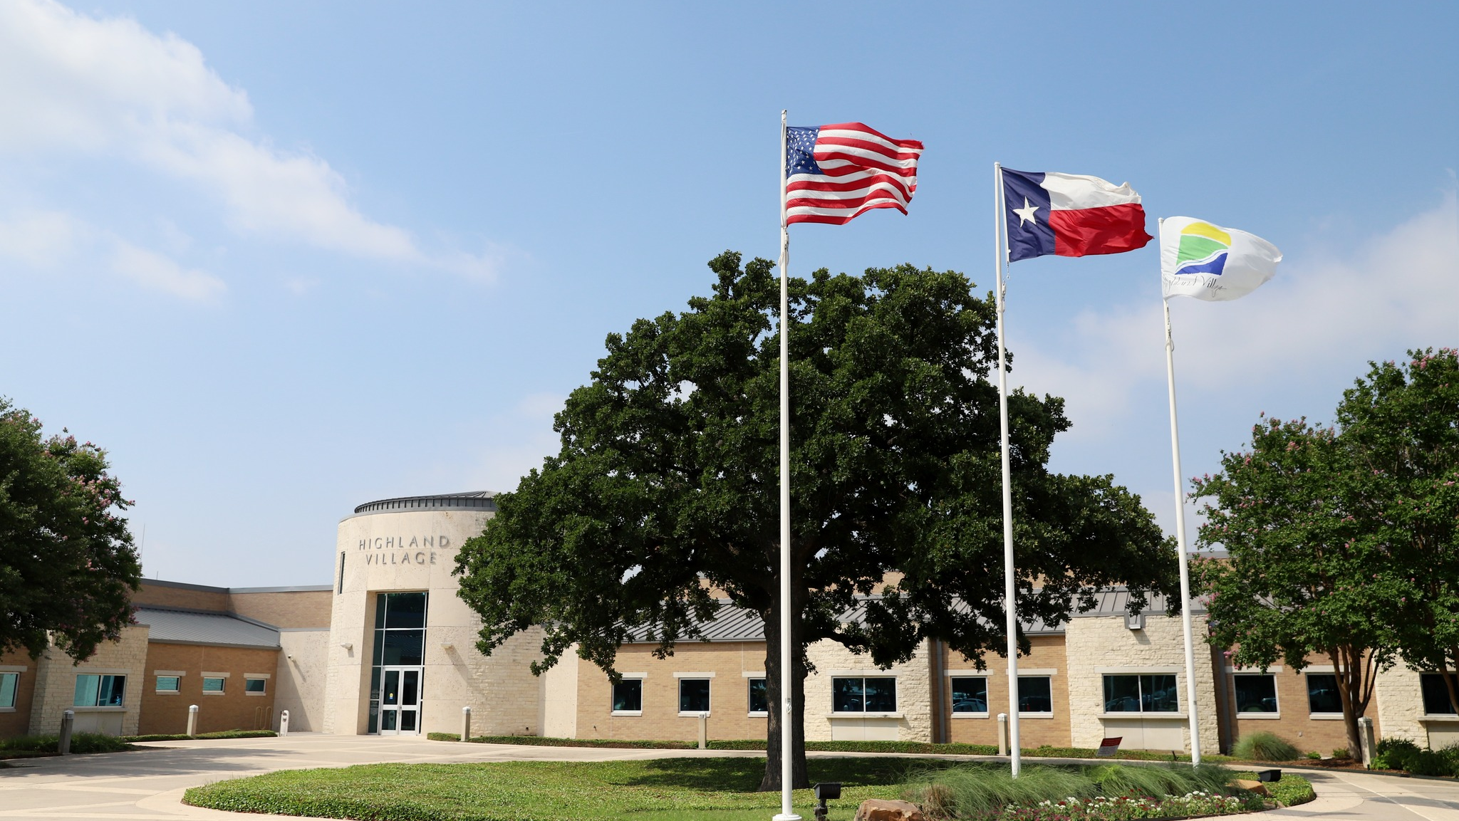
Thank You!

